Slide 1
PIZZA CRUSH
Group-8
1)Rishi Reddy KOLANU
2)Gowtham kesa
3)Nagendra beesabathuni
4)Sourab REDDY PAILLA

Slide 2
What is pizza crush?
Pizza Crush is a web-based application pizza ordering system which allows customer to either order pizzas from menu or order their favorite customized pizzas by selecting the required crust, toppings and sauces.

Slide 3
Features:
Ordering pizzas from the menu as in existing system.
Ordering their customized pizzas by selecting breads, toppings, sauces.
The bill is generated dynamically and is displayed as soon as customer selects an item.
Customer can view the final image after selecting custom pizza and toppings. This image is generated by overlapping pizza and toppings images.

Slide 4
Nice to Have:
Payment Gateway
Email confirmation of orders

Slide 5
Technologies used / Technical requirements:
CodeIgniter (PHP framework)
JavaScript
CSS
HTML5
MYSQL
Bootstrap CSS
Apache Tomcat Server
Wamp Server

Slide 6
Hardware requirements
For hosting the website locally:
Processor: Intel Core i3 or above
Processor speed: 2.4 GHz or above
RAM: 4 Gb or more
Hard disk: 500 Gb or more

Slide 7
Non-Technical requirements:
Reliability: Reliability is the probability that a system will fail in a given period. A distributed system is reliable if it keeps delivering its service even when one or multiple components fail. Reliability is achieved through redundancy of components and data (remove every single point of failure).
Availability: Availability is the time a system remains operational to perform its required function in a specific period. Measured by the percentage of time that a system remains operational under normal conditions.

Slide 8
Non-Technical requirements:
Efficiency
Latency: response time, the delay to obtain the first piece of data.
Bandwidth: throughput, amount of data delivered in a given time.

Slide 9
Project Management tool
Tiago.io
Taiga is a project management platform for agile developers & designers who want a simple, beautiful tool that makes work truly enjoyable.

Slide 10
Version Control System
Git hub
GitHub is a Git repository hosting service. It is a repo for the code base of the project.

Slide 11
Development Methodology
Agile
Agile development methodology is being used to minimize risk (such as bugs, cost overruns, and changing requirements) when adding new functionality. Team develop the software in iterations that contain mini-increments of the new functionality that is being considered

Slide 12
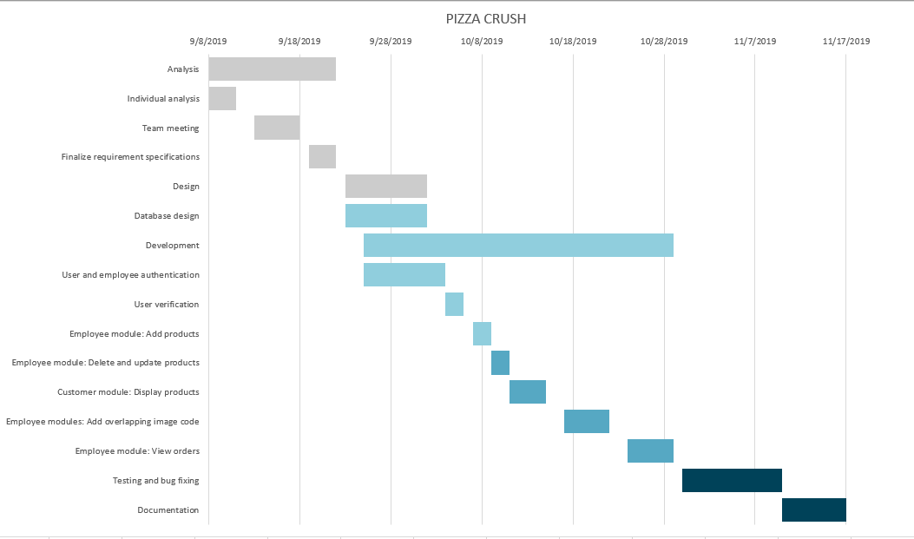
Gantt chart

Slide 13
Risk Management
1.Security risk:
For every project threat modelling is an important stage. Threat modeling is a family of activities for improving security by identifying objectives and vulnerabilities, and then defining countermeasures to prevent, or mitigate the effects of, threats to the system. A threat is a potential or actual undesirable event that may be malicious (such as DoS attack) or incidental (failure of a Storage Device). Threat modeling is a planned activity for identifying and assessing application threats and vulnerabilities. It might become difficult to address security related issues are we lack the expert in this region and due to time constraints as well we consider this as a major risk. To mitigate this risk security expert is identified and it is timely monitored.

Slide 14
Risk Management
2.Testing and Test scripts
Implementing risk analysis in software testing typically requires a detailed evaluation of the source code to identify how it interacts with other components of a complete application. This evaluation looks at the various code components and maps how the code interacts. With this map, transactions can be identified and evaluated. Architectural and structural rules can be applied to the map to understand where software flaws lie, and which ones are the most important given the transactions flowing through the application. Such kind of risk might rise due to lack of knowledge on the testing scripts. To mitigate this risk testing expert is ramping up on mastering the testing and writing scripts.

Slide 15
Risk Management
3. UX Design
Most new products are probably carefully designed around user needs, user stories or typical personas. However, this is not always going to guarantee that your product will be useful and desirable or that it will be a commercial success. So, there is always a need for a UX advocate to tackle the failures of the product caused due to bad UI design. To mitigate such kind of a risk a UX advocate is identified and the tasks are monitored timely to ensure the design is simple to use for the user.

Slide 16
Team members roles
Sourab Reddy Pailla (Group Leader and Manager)
Gowtham Kesa (Product owner and Security expert)
Rishi Reddy Kolanu (Architect and Developer)
Surya Nagendra (Scrum Master and Testing Lead)

Slide 17
Thank you ☺

